Slide 1
A Journey Through Magnetism

Slide 2
Magnetic Moment

Slide 3
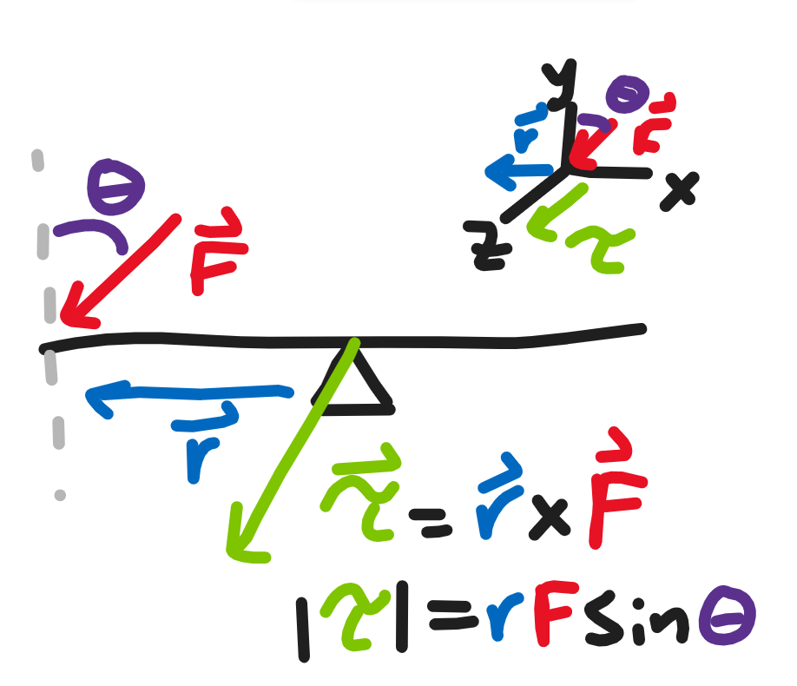
Torque
If we apply a force to a lever, it begins to rotate about its pivot.
We have given it some “rotational” version of force, called torque.
We maximize the torque by applying the force at a 90 degree angle to the lever and minimize it with a 0 degree angle.
For a lever a length r from its pivot, applying a force F at an angle θ produces a torque Τ where Τ = rFsin(θ).
However, rFsin(θ) does not have a direction, so instead say Τ = r×F, where the × gives us the proper magnitude and direction.

Slide 4
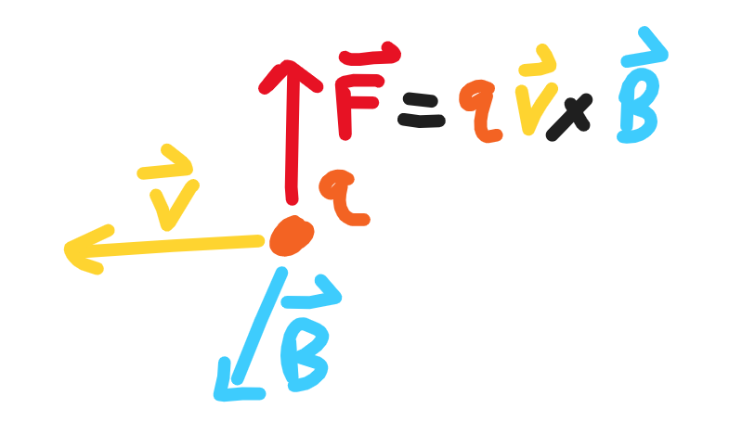
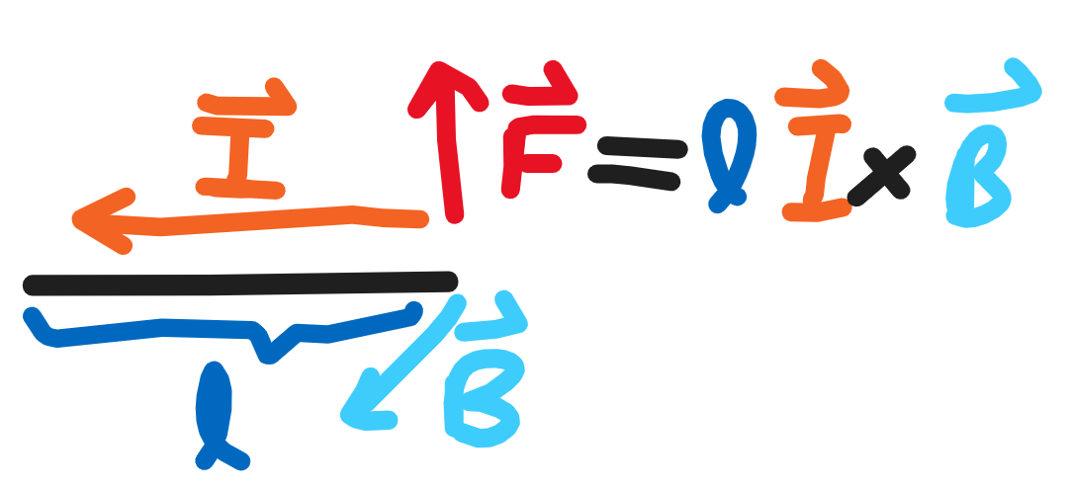
Magnetic Force
Charged particles feel a force from the electric and magnetic fields.
For a particle of charge q moving at a velocity v at an angle t to a magnetic field B, the force F on that particle is given by the equation F = qv×B (derivation).
We can note that current, I, is the amount of charge flowing in a unit of time, so for a wire of length l, we can rewrite qv as Il.
Thus, F = lI×B.

Slide 5
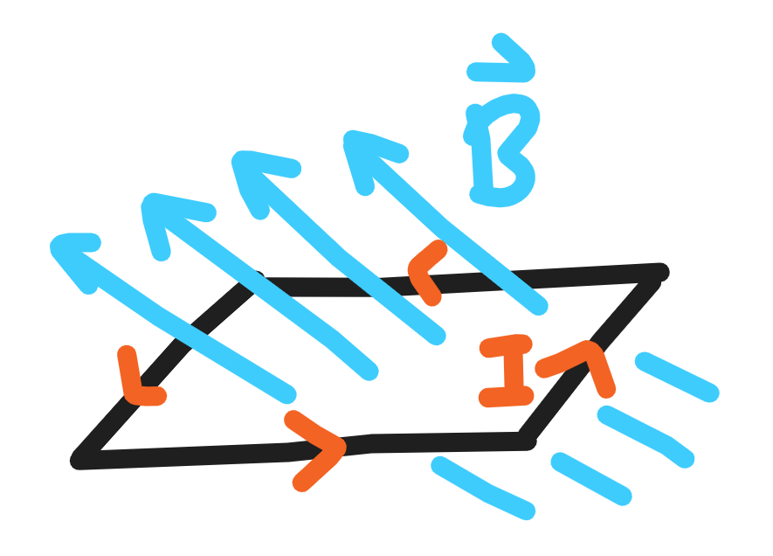
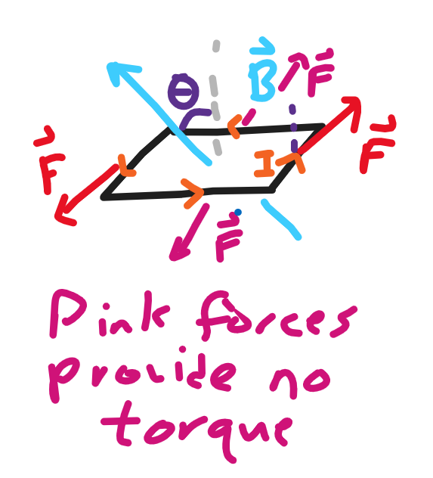
Loop of Wire
Consider now a rectangular loop of current with a magnetic field passing through it such that B is completely orthogonal to one side of the loop..
There is a force on each side of the rectangle, thus providing a torque on our current loop.
There is a force on each side of the rectangle, thus providing a torque on our current loop.
Notice that two forces provide torques and two forces do not. Let the sides where the forces do not provide torque have length w and the other sides have length l.

Slide 6
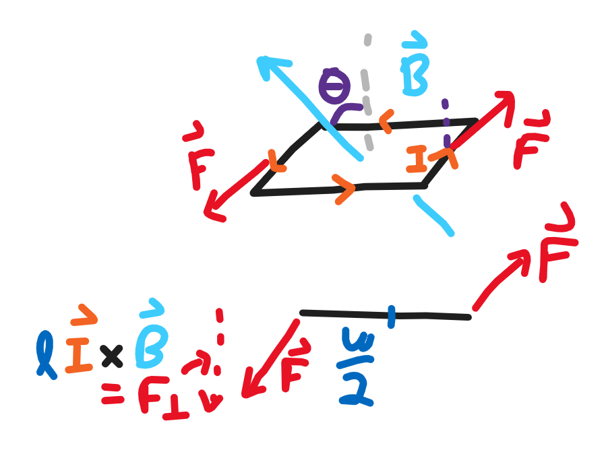
Loop of Wire (continued)
The forces that provide torques are IlB, and the torques provided are IlBsin(θ) = lI×B.
Each of our forces are a distance w/2 away from the center (where the loop will rotate), so each force causes a torque of l(w/2)I×B.
As there are two forces, a total torque of lwI×B is created where lw is the area of our loop, which we will call A = lw.
Thus, in general, AI×B gives torque, even for non-rectangular loops with more general magnetic fields.

Slide 7
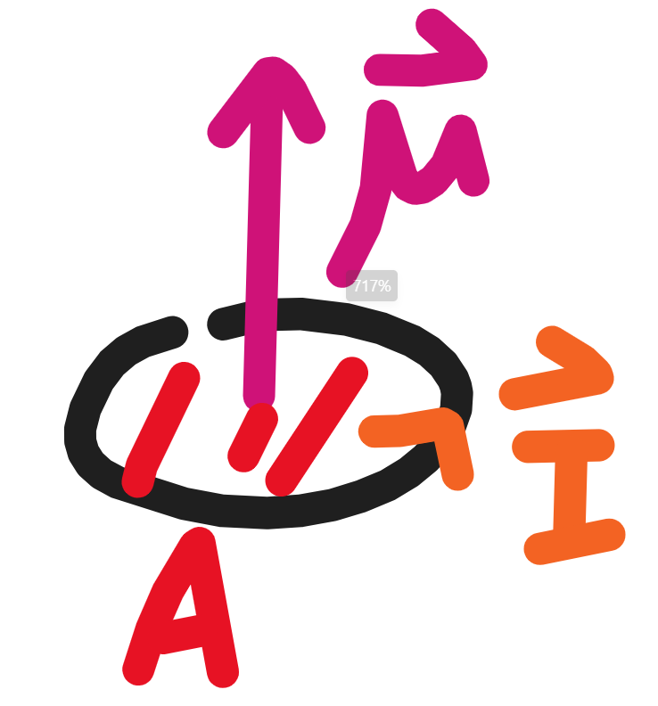
Magnetic Moment
It is useful to make the quantity AI one term, which we will call µ.
For any object, we can say µ = IA and µ×B will give the torque on the object due to the magnetic field.
The direction of our magnetic moment is the curl of the current I, which is perpendicular to the face of our loop.

Slide 8
Angular Momentum

Slide 9
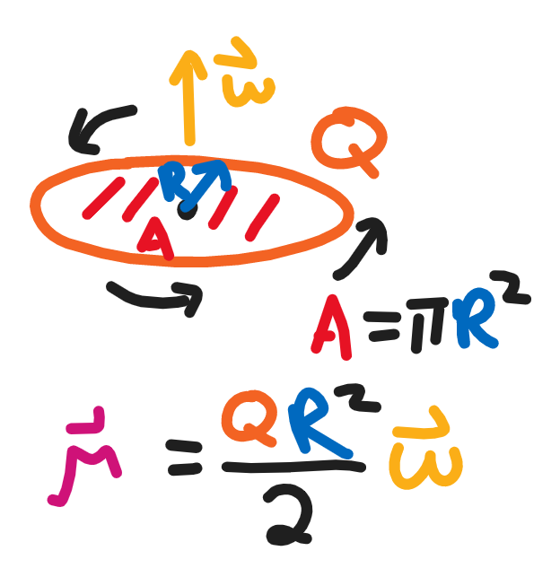
Ring of Stationary Charge
Consider a ring of stationary charge with radius R.
Angular velocity is the radians traveled per second for an object. For an object moving at a velocity v around a circle of radius R, the angular velocity ω is given by ω = v/R.
Spinning this ring with angular velocity w means that it takes a time of t = 2π/ω for all the charge Q to travel 2π radians, or a full cycle around the ring.
Thus, the current in the ring is I = Q/t, which is Qw/(2π).
Recall µ = IA = [Qw/(2π)]πR² = QR²ω/2.

Slide 10
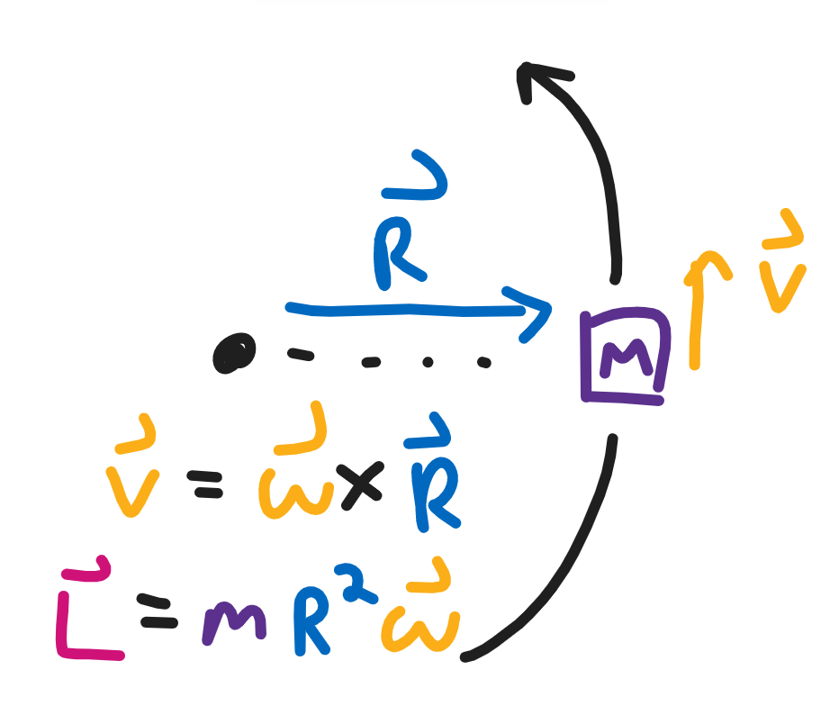
Angular Momentum
Linear momentum is the integral of force with respect to time.
By Newton’s second law, F = ma where m is mass and a is acceleration.
Linear momentum p is thus mass times velocity as velocity is the integral of acceleration with respect to time.
Similarly, angular momentum, L, is the integral of torque with time, which, for a particle moving in a circle of radius R, is mvR = mR²ω.

Slide 11
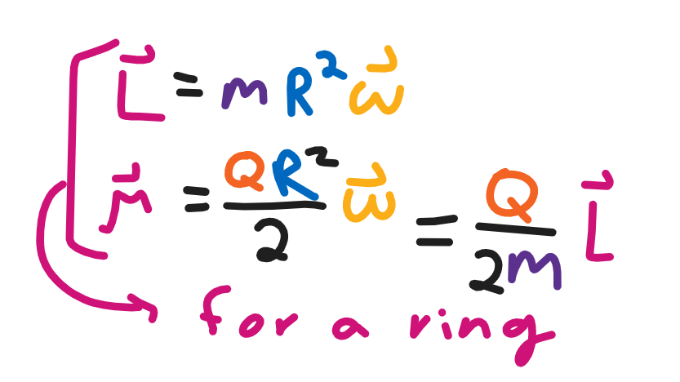
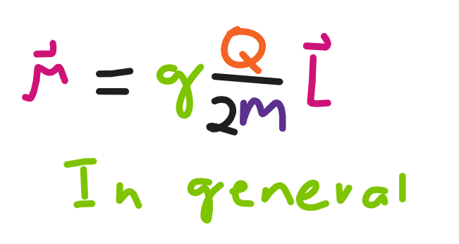
Gyromagnetic Ratio
Recall µ = QR²ω/2 and L = mR²ω.
Thus, µ = [Q/(2m)]L.
However, recall that this was for a ring of charge, what about for some other distribution of charge? A particle?
More generally, we say µ = [gQ/(2m)]L where g is a dimensionless scale factor, often around 2 for elementary particles.
Regardless, the important idea is that µ, our magnetic moment, is directly proportional to the angular momentum of a particle.
For simplicity, let r = gQ/(2m).

Slide 12
Angular Momentum

Slide 13
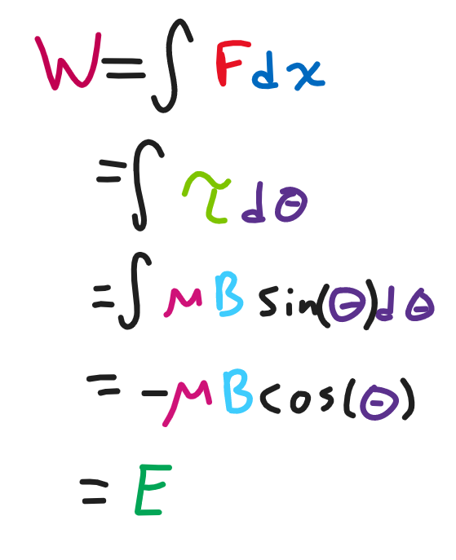
Work-Energy Theorem
You may have heard that work is the amount of force applied over a certain distance.
In rotational mechanics, we can say that work is the torque applied over a certain angle.
We can integrate magnetic torque over our angle t to get the work done by the magnetic field as W = -µBcos(θ).
Energy is the ability to do work, so the more work is done by the magnetic field, the less energy there is.
Thus, E = W.

Slide 14
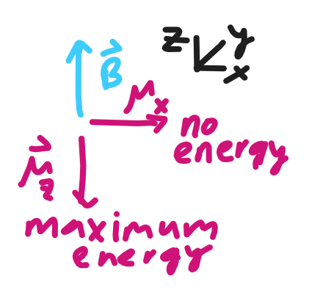
Angular Momentum and Work
Let us say µBcos(θ) = µ⋅B, where ⋅ is our dot product.
Note if µ is perpendicular to B, then θ = 90, so our dot product returns 0.
Recall µ = rL, so µ⋅B = rL⋅B.
Let’s say L = J_{x} + J_{y} + J_{z} where each J_{i} represents the angular momentum in the x, y, or z direction.
Then, if B is in the z direction only, L⋅B = J_{z}B only as the J_{x}, J_{y} terms are perpendicular to B, so the dot product returns 0.

Slide 15
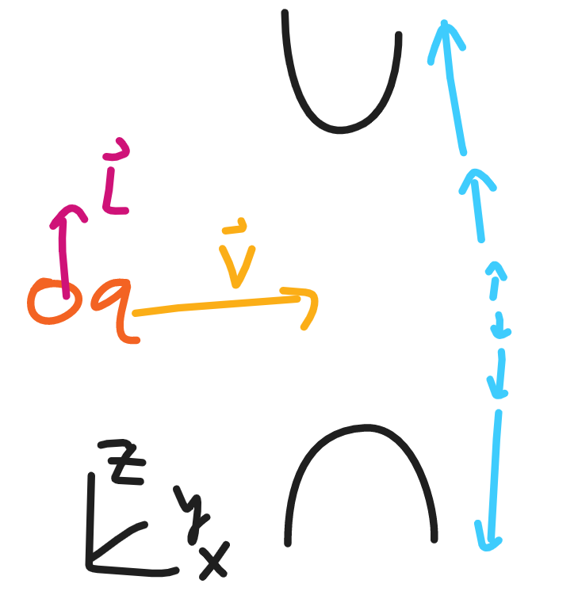
Uneven Magnetic Field
Now consider an elementary particle fired along the positive x direction along z = 0.
Along the z direction, let’s say there’s an uneven magnetic field B = B₀ + bz. Thus, the magnetic field is stronger the higher up you go.
Energy is E = -µ⋅B = -rJ_{z}(B₀ + bz).
Work done by the field is W = E.
Energy decreases as we apply a force, so we say energy is the negative spatial derivative of force.
Thus, F = -dE/dz = rJ_{z}b.

Slide 16
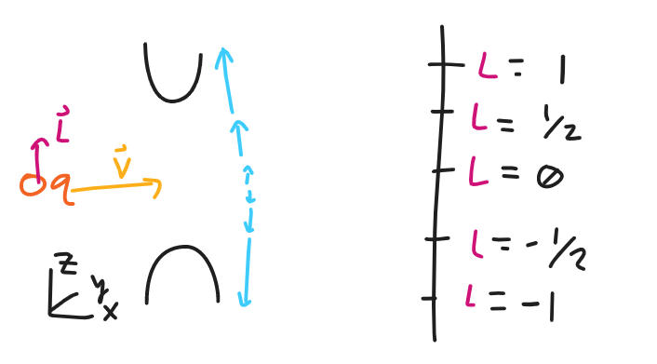
Uneven Magnetic Field (continued)
This means different forces are applied to particles with different angular momentums in the z direction.
Now after shooting the particles through the magnetic field, place a board parallel to the z-axis some distance away.
If we look at where the particles land, we can calculate the initial angular momentum.
We expect a continuous distribution of where particles land if angular momentum is continuous.

Slide 17
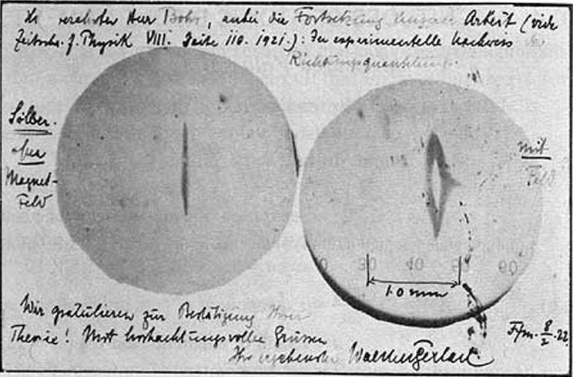
Stern-Gerlach
Stern-Gerlach did this experiment and found that there was a clear split between where the particles landed.
This suggests angular momentum, in particular spin angular momentum, is actually discretized.

